Slide 1
First Term Success Workshop
Career Planning
Notes:
FACILITATOR GUIDE:
Career Planning has many facets, setting goals and expectations for yourself will push you to be your best version.

Slide 2
Enabling Objectives
DEFINE a contract obligation, reenlistment, extension, zone of enlistments, and military obligation service (MSO)
DEFINE the purpose of CDBs per the Career Counselor Handbook, NAVPERS 15878 (series)
IDENTIFY Individual Career Development Plan (ICDP) discussion topics in accordance with applicable directives
IDENTIFY Navy Wide Advancement Exam eligibility per the Advancement Manual for Enlisted Personnel of the U.S. Navy and U.S. Navy Reserve, BUPERSINT 1430.16 (series)
ANALYZE Navy Wide Advancement Exam results in accordance with applicable directives
LIST eligibility requirements for commissioning programs per the Enlisted to Officer Commissioning Programs Application Administrative Manual, OPNAVINST 1420.1 (series)
DISCUSS First Termers Military Obligation Service (MSO)
IDENTIFY U.S. Navy Reserve programs in accordance with applicable directives
IDENTIFY basic Transition Assistance Program procedures
Notes:
FACILITATOR GUIDE:
Review objectives

Slide 3
References
OPNAVINST 1040.11 (series)- Navy Enlisted Retention And Career Development Program
NAVPERS 15878M- Career Counselor Handbook
BUPERSINST 1430.16G- Advancement Manual for Enlisted Personnel of the U.S. Navy and U.S. Navy Reserve
OPNAVINST 1420.1B- Commissioning Programs Manual
OPNAVINST 1900.2D- Transition Assistance Program
My Navy Portal, Career Planning- https://www.mnp.navy.mil/group/career-planning/ladr
Navy Credentialing Opportunities Online (COOL), Understanding Your LADR/OARS- https://www.cool.osd.mil/usn/resources_and_links/index.html?UnderstandingYourLadr
Enlisted Community Manager page- https://www.mynavyhr.navy.mil/Career-Management/Community-Management/Enlisted/Administration/
Notes:
FACILITATOR GUIDE:
Review references

Slide 4
Contract Obligation
Length of time you are required to obligate service (OBLISERV) per assignment.
Calculated in months.
Length determined by number of sea/shore commands you have been previously assigned to.
Can be fulfilled via reenlistment or extensions.
Notes:
FACILITATOR GUIDE:
Explain where the OBLISERV (if applicable) is located on member's orders.
Orders will state length of OBLISERV required.
Recommend referring member to Prescribed Sea Tour (Incentive 3) if there is a question regarding to the length determined vs contract obligation.
Member can also reenlist first, then execute an extension as long as the OBLISERV is fulfilled.

Slide 5
Reenlistment
Reenlistment term: 2, 3, 4, 5, or 6 years
Recommended for retention by CO
Must be rated
Must be physically and medically qualified
Must have an approved Career Waypoints (C-Ways)– Reenlistment quota
Cannot exceed High Year Tenure (HYT)
Notes:
FACILITATOR GUIDE:
Explain members must receive at least a Promotable on the most current evaluation (periodic or special) for CO’s retention recommendation.
PACT Sailors with required A-school will not be able to reenlist until they graduate from the A-school.
Member with 2 consecutive PFA failures will have to refer to NAVADMIN 043/23 (Physical Fitness Failures Reset).
Explain C-Way approval quota expiration (as applicable).
Explain High Year Tenure (HYT) and HYT Plus Pilot (NAVADMIN 288/22).
E3 – Rated, 6 years
E4 – 10 years
E5 – 16 years
E6 – 22 years
E7 – 24 years
E8 – 26 years
E9 – 30 years

Slide 6
Extension
Extensions can be executed for minimum 1 month up to maximum 48 months.
Reason for Extensions (School, PRD, HYT, Retain in service, etc.)
Sailor whose enlistment contract ends prior to their duty station tour lengths will be asked to obligate service (OBLISERV) to complete their prescribed tour.
Notes:
FACILITATOR GUIDE:
Must be recommend for retention by CO.
Explain the difference between the terms execution date and operative date.
Execution date is the date the Sailor signed the extension.
Operative date is the date the extension goes into effect; EAOS + 1 Day.
This is not an all inclusive list, see MPM 1160-040, page 4-6 for additional reason a Sailor can extend for.
An inoperative extension will be cancelled if member reenlists. The reenlistment must take them past the number of months already obligated in their previous extensions.

Slide 7
Zones of Enlistment
Zone A: 0 – 6 Years
Zone B: 6 – 10 Years
Zone C: 10 – 14 Years
Zone D: 14 – 20 Years
Zone E: >20 Years
Notes:
FACILITATOR GUIDE:
Review reenlistment zones.

Slide 8
Military Obligation Service (MSO)
All First Termers must serve in a Military Service for a total initial period of not less than 6 years nor more than 8 years, unless discharged under regulations prescribed by the Secretary of Defense or (for Navy personnel) the Secretary of the Navy (SECNAV)
MSO can be completed by 4 years Active duty/ 4 years Reserve or 4 years Active duty/ 2 years Selective Reserve (SELRES)/ 2 years Inactive Ready Reserve (IRR).
Notes:
FACILITATOR GUIDE:
Explain to First Termers their MSO can be found in their original contract located in their OMPF on BOL.

Slide 9
Career Development Boards (CDB)
Career Development Boards (CDBs) are the primary delivery method to ensure Sailors are provided guidance to make informed career decisions based on current Navy policies, programs, and procedures.
The CDB schedule consists of Reporting, 24 month/CWAY, 48 month, and 60-month CDB’s.
The CDB schedule for PACT Sailors consists of Reporting, 6/12/18 months.
Additionally, a CDB shall be conducted for Advancement, Commissioning, Education, Separation, etc. or at the request of the Sailor.
Notes:
FACILITATORS GUIDE:
Presenter can explain why CDBs are important in helping Sailor plan their career with assistance from their respective chain of command.
Cover the Individual Career Development Plan (ICDP)
Mutually developed plan
Assists in achievement of personal and professional goals
The Sailors' take away from a CDB

Slide 10
Navy Wide Advancement Exam (NWAE)
Eligibility
Must be recommended by CO, have minimum time-in-rate (TIR), be in proper path of advancement, have completed the Professional Military Knowledge – Eligibility Exam (PMK-EE) for the next paygrade applicable for E-4 through E-7 paygrades.
*E-4 do not take advancement exams (effective as of NAVADMIN 274/22)
Navy Advancement Center (Accessible from MyNavy Portal)
Bibliographies, rating Topics & Subtopics, time-In-Rate (TIR) Calculation Table, enlisted Advancement Worksheet, and profile sheet
Enlisted Advancement Worksheet (EAW)
View via MyNavy Portal link or NSIPS Self-Service Account, Sailors can upload supporting documents and make comments, and educational Services Officer (ESO) can assist with EAW access issues
Notes:
FACILITATOR GUIDE:
Specify the exam cycle NAVADMIN PMK-EE completion deadline and that it must be completed by the deadline or the Sailor will render themselves ineligible for the advancement exam.

Slide 11
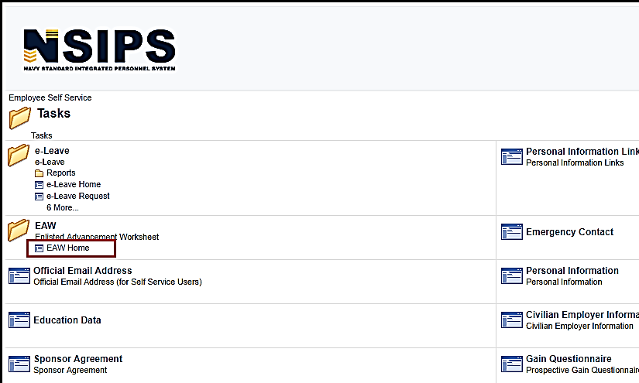
Enlisted Advancement Worksheet
Step 1: Log in to NSIPS.
Step 2: Click on “Employee Self Service”
Step 3: Click on “Tasks”
STEP 4: Click on “EAW Home”
Notes:
FACILITATOR GUIDE:
The Enlisted Advancement Worksheet is located on NSIPs.
Once logged in:
Click on Employee Self Service → Tasks → under EAW, click on EAW home.

Slide 12
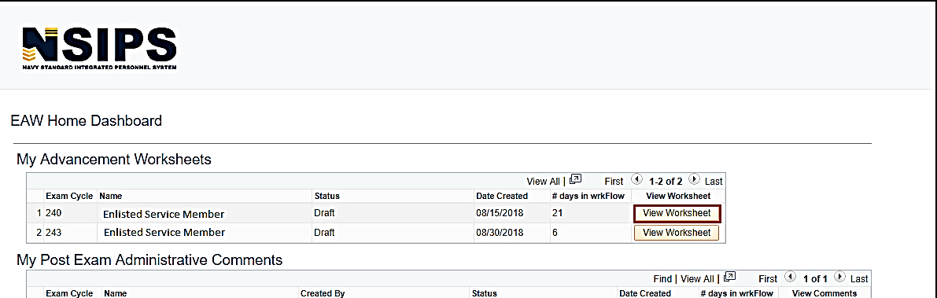
Enlisted Advancement Worksheet cont…
Step 5: Click on the UPCOMING worksheet.
Note: If you have completed multiple cycles of worksheets via NSIPS, there may be several available.
Notes:
FACILITATOR GUIDE:
None

Slide 13
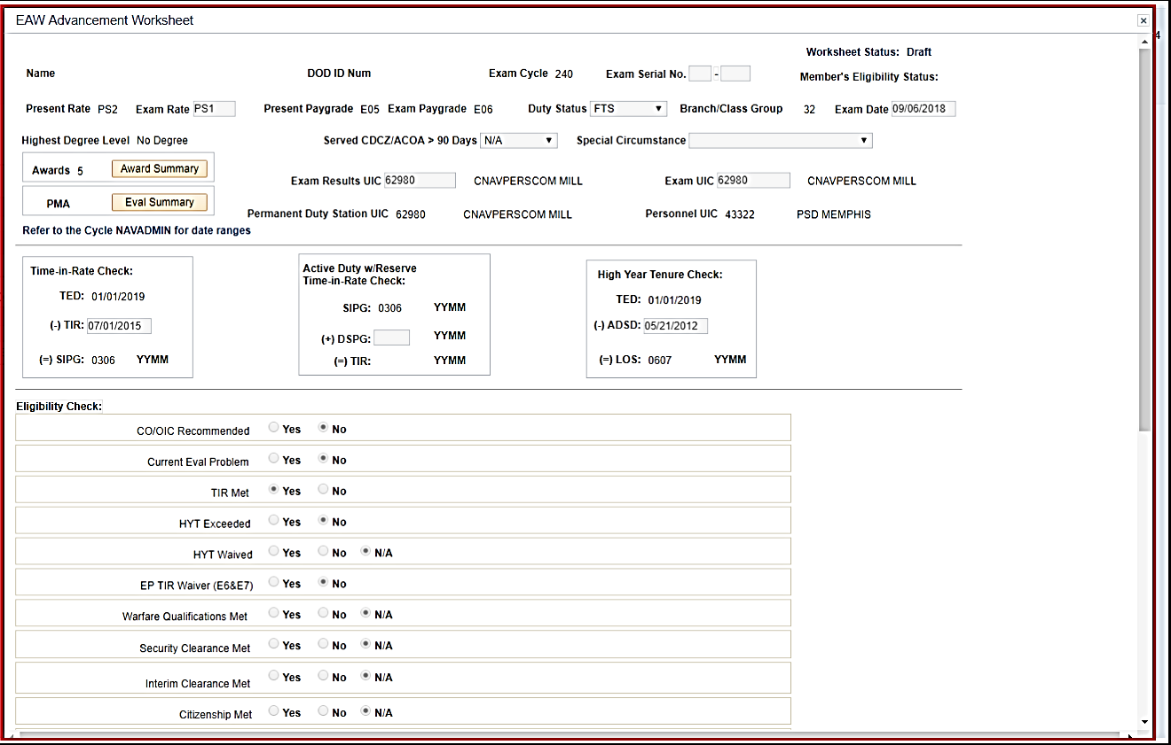
Enlisted Advancement Worksheet cont…
A new window will pop up – this is your Electronic Advancement Worksheet (EAW).
Step 6: Verify your information
DOD ID Number
Exam Cycle
Present Rate/Exam Rate
Present Paygrade/Exam Paygrade
Highest Degree Level
Duty Status
Are you taking the exam for a special circumstance (i.e. EP Waiver or LDO purposes)
Exam Results – will you still be at this UIC when results are expected to be released?
Exam UIC – Are you transferring before taking the exam?
Time in Rate
Notes:
FACILITATOR GUIDE:
Once the Sailor has clicked “View Worksheet” – a pop up window will appear (they may need to enable their pop-ups!)
This is their actual worksheet.
Sailors should verify ALL of the data/information to ensure everything is accurate.
Why is it important to verify Time in Rate?
1. To verify the Sailor is actually eligible for the exam and
2. because it involves points on the overall score. If TIR is only showing 0300 vice 0500 – this is a big difference.

Slide 14
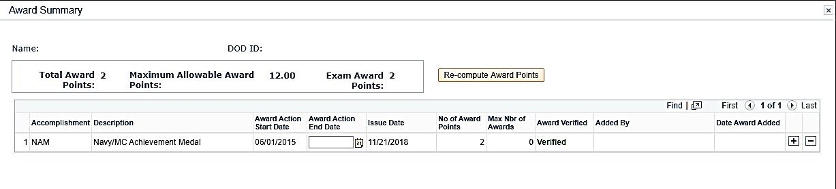
Enlisted Advancement Worksheet cont…
Step 7: Click on Award Summary to verify your awards are correct.
If the awards do not show “Verified”, you will have to upload a copy of the
award for the ESO to verify.
Notes:
FACILITATOR GUIDE:
Awards:
This is where we see the most issues once results have been released and a Sailor missed the exam by less than 2 points.
Check NDAWS, the PSR, NSIPS Awards History, etc. to verify all awards (if applicable) are listed here.
Notice it says Maximum Allowable Award Points – The Sailor could have 14 points, but the maximum allowable is only 12 points. That is all they will receive, not the entire 14 points.
As per BUPERSINST1430.16G paragraph 307 – Enter points only for awards APPROVED or EARNED prior to the day of the regularly scheduled NWAE. Awards with only a month/year date are presumed to have an ending date on the last day of the respective month.

Slide 15
Enlisted Advancement Worksheet cont…
Step 8:
Verify Eval Summary
NAVADMIN will specify which evaluations to use for the advancement cycle.
Each day should be accounted for to ensure continuity is maintained.
Notes:
FACILITATOR GUIDE:
Current rank – only the evals in your current rank can be utilized on the EAW. Example if the Sailor is taking the E5 exam, only the E4 evals can be utilized.

Slide 16
Enlisted Advancement Worksheet cont…
Education points are ONLY authorized if your degree is annotated on your Joint Service Transcript.
**This is NOT something your ESO can add unless it is in your JST. A copy of your diploma will NOT suffice**
How to update your JST:
Active Duty and Veterans: Have an official transcript sent from the institution directly to the JST Operations Center. Transcripts supplied by service member will NOT be accepted; they must come DIRECTLY from the institution.
NETPDTC
ATTN: JST Technology Operations Center, Code N644
6490 Saufley Field Road
Pensacola, FL 32509
DSN: 753-6013
Email: jst@doded.mil
Notes:
FACILITATOR GUIDE:
Per BUPERSINST 1430.16G “Education points will be calculated and credited by the Joint Services Transcript (JST). Naval Education and Training Professional Development Center (NETPDC) will receive data from Navy College Management Information System for calculations into the Candidate’s FMS.

Slide 17
Enlisted Advancement Worksheet cont…
Eligibility Check:
This shows the Sailor and the ESO
if there are currently any issues
with a Sailor’s record that could
interfere with their eligibility.
In the upper right-hand corner, it
states “Member’s Eligibility Status”:
Potentially Eligible or Potentially Ineligible
Notes:
FACILITATOR GUIDE:
PMK-EE:
Required ONCE per paygrade. This is a MANDATORY requirement and it SHALL be completed prior to the date annotated in the NAVADMIN.
You can NOT front load the PMK-EE Training i.e. An E4 cannot go knock out their E5, E6, and E7 PMK-EE. It has to be done during that particular paygrade before the exam.
If a Sailor does NOT complete their PMK-EE prior to the due date – they will be ineligible for the exam.

Slide 18
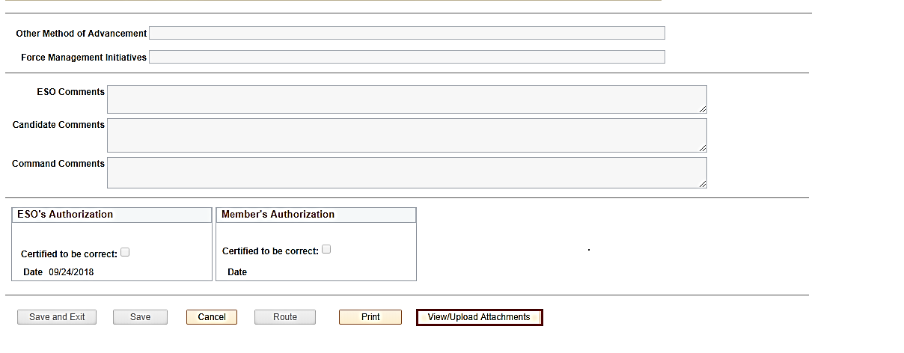
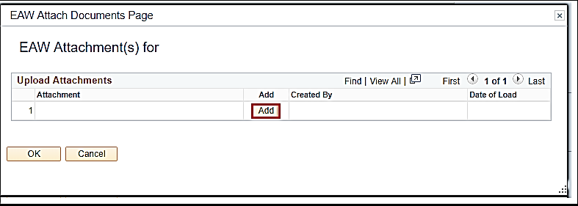
Enlisted Advancement Worksheet cont…
Step 9:
Add and upload each document that was previously identified as missing or not verified.
Notes:
FACILITATOR GUIDE:
If something is CHANGING on the EAW, there has to be proof/documentation to what is changing and WHY.

Slide 19
Enlisted Advancement Worksheet cont…
Step 10: Input comments to the Command ESO.
Example: “Added missing awards, should have 8 points total. Added missing transfer eval for period 18JUN23-19MAR15.”
Step 11: SAVE your work!
Notes:
FACILITATOR GUIDE:
None

Slide 20
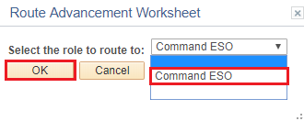
Enlisted Advancement Worksheet cont…
Step 12: Once all documentation has been uploaded, all evals are correct, and nothing else is missing – check both boxes:
“I hearby verify the information contained hereon and certify it to be correct.”
“Certified to be correct.”
Step 13: Route to ESO. This may say Command ESO, Assistant ESO, or just ESO.
Notes:
FACILITATOR GUIDE:
None

Slide 21
Exam Profile Sheet
Your Profile sheet provides the results from the advancement exam
Final Multiple Score (FMS)
Passed Not Advanced Points (PNA)
https://nsipsprod.nmci.navy.mil/nsipsclo/jsp/index.jsp. In the Training, Education and Qualifications tab, click on "View Training, Education and Qualifications." Click on "Exam Profile Data​
Notes:
FACILITATOR GUIDE:
Presenter can explain how the EAW works to provide specify information on the Profile Sheet; can breakdown the columns on here and then on the next slide for the FMS calculation. Presenter can also explain how to add an email to receive Profile Sheet Update notifications via BOL.

Slide 22
Commissioning Programs
Basic Requirements:
U.S. Citizen
Physically qualified
Age
Testing
Recommended by your Commanding Officer
Naval Academy | Naval Academy Preparatory School (NAPS) | Seaman to Admiral (STA-21) | Medical Enlisted Commissioning Program (MECP) | Officer Candidate School (OCS)
Provides 4 years of college education Must be 17 and not older than 23 on 1 July of entrance year Unmarried with no legal responsibility to support others | Provides intensive preparation for the academic, military, and physical training curriculum at the Naval Academy Offered direct appointment to the Naval Academy Must be not older than 22 as of 1 July of the entrance year | Minimum 1000 SAT 41 ACT (combined Math/English) Two components: 8 weeks at Naval Science Institute (NSI) 36 months at NROTC university Receive full pay and allowances Eligible for advancement | Provides opportunity to commission in the Nurse Corps Minimum 1000 SAT 42 ACT (combined Math/English) Can be up to 42 years old Receive full pay and allowances Eligible for advancement | Must have a Bachelor's degree 12 weeks of officer candidate indoctrination and training 22 different fields available Each designator has its own prerequisites
Notes:
FACILITATOR GUIDE:
Additional Notes:
Other Commissioning Options: Medical Service Corps In-Service Procurement Program (MSC-IPP), Limited Duty Officer (LDO), Chief Warrant Officer (CWO), Judge Advocate General’s In-service Procurement Program (JAG-IPP), Enlisted to Medical Degree Program.
Ensure to mention MyNavyHR-references-messages where NAVADMINs will be published with more information for each fiscal year.

Slide 23
Learning & Development Roadmap (LaDR)
Guide developed to assist in mentoring/developing Sailors
Allows you to chart and track goals to include:
Skills Training
Personal & Professional Growth
Professional Military Education
Education
You can access LaDR using MyNavy Portal (MNP):
Path: Career & Life Events; Career Planning; LaDR
https://www.mnp.navy.mil/group/career-planning/ladr
Notes:
FACILITATOR GUIDE:
If unable to pull up and display online have a printed example copy on hand.

Slide 24
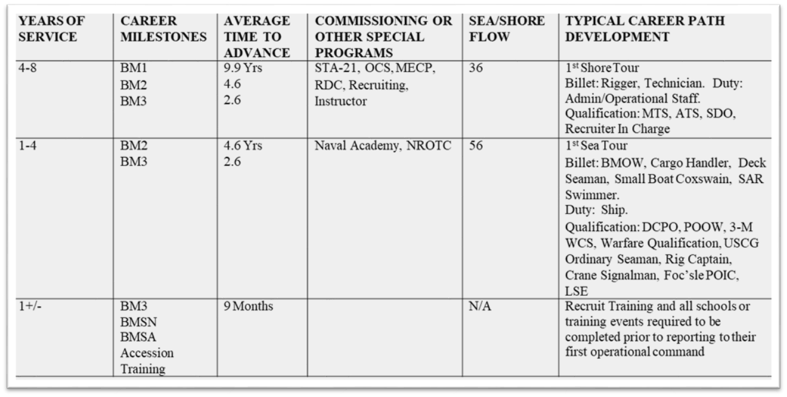
Career Path
Notes:
FACILITATOR GUIDE:
Presenter can elaborate on how using the Career Path and LaDR would be beneficial to planning a successful Career and assisting with increased possibility for Advancement.

Slide 25
Transition
Navy Reserves
Selected Reserves (SELRES)
1 weekend a month and two weeks a year
2 year involuntary mobilization deferment (6 months)
1 year involuntary mobilization deferment (12 months)
Benefits of SELRES
Reserve retirement
Pay and affiliation bonuses
SGLI/ FSGLI
Educational opportunities
Medical benefits
TAMP (Transitional Assistance Management Program)
Eligible to get activated if desired
Individual Ready Reserves (IRR)
Personnel fulfilling their 8 year military service obligation (MSO)
Not required to drill
Required to maintain physical, medical, and dental readiness standards
No pay unless activated
Notes:
FACILITATOR GUIDE:
Address submission via CWAY and who the Local SELRES Recruiter is for the respective AOR.

Slide 26
Transition Assistance Program
Provides separating and retiring service members the skills, tools and self-confidence necessary to successfully re-enter the civilian work force
Five key components of TAP
Mandatory initial counseling/ self assessment at least 365 prior of separation
Mandatory pre-separation counseling at least 365 days prior of separation
Mandatory TAP core curriculum
Selection of two-day track if not waived
Mandatory Capstone event
CCC
Self-Assessment & Initial Counseling
Pre-Separation Counseling
DOD Transition Day
VA Benefits/
DOLEW Workshop
2-Day Career Track
CAPSTONE
Must be completed no later than 90 days prior to separation
Mandatory
Completed 365 days from separation
DAY 2
Mandatory
My Transition
Military Occupational Code Crosswalk
Financial Planning
DAY 3
Mandatory
VA Benefits
Department of Labor Employment Workshop
DAY 4 & 5
• Employment Track: Employment Workshop • Education Track: Managing Your (my) Education • Vocational Track: Career and Credential Exploration • Entrepreneurship Track: Boots to Business
DAY 1
Mandatory
Completed 365 days from separation
Notes:
FACILITATOR GUIDE:
Speak on the respective Fleet & Family Support Center for that AOR and who the TAP Coordinators are.

Slide 27
Review and Summary
Career Development Boards
Advancement
Commissioning Programs
LaDR
Military Obligation Service (MSO)
Transition
Questions?
Notes:
FACILITATOR GUIDE:
Questions to ask the class:
What is the purpose of a CDB? What is the CDB Schedule? What is the PACT CDB Schedule? What paygrades take the NWAE? When is the PMKEE deadline? What is an EAW? What is a Profile Sheet? How many years is your MSO?
Presenter can tailor review questions to the audience.

